Slide 1
Satish Pradhan Dnyanasadhana College (Arts, Science & Commerce)
Art Circle and Utopia presents
V UTOPIA
Theme - RESURGENCE: Rising again into the life
February 16th to 24th 2021

Slide 2
EVENT # 1: Inauguration of v-Utopia Web Page INAUGURATION by Chairman Satish Pradhan sir and Secretary Shri. Kamlesh Pradhan
Date: 10th Feb

Slide 3
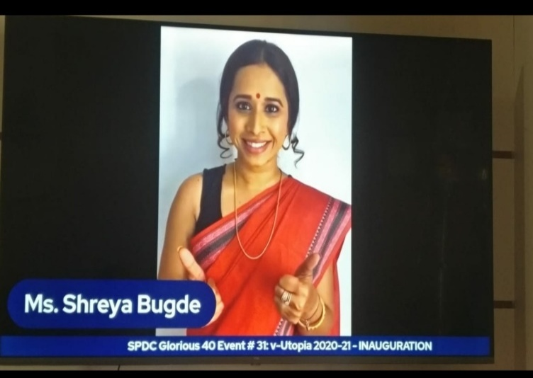
EVENT # 2: Inauguration of v-Utopia
Date: 16th Feb

Slide 4
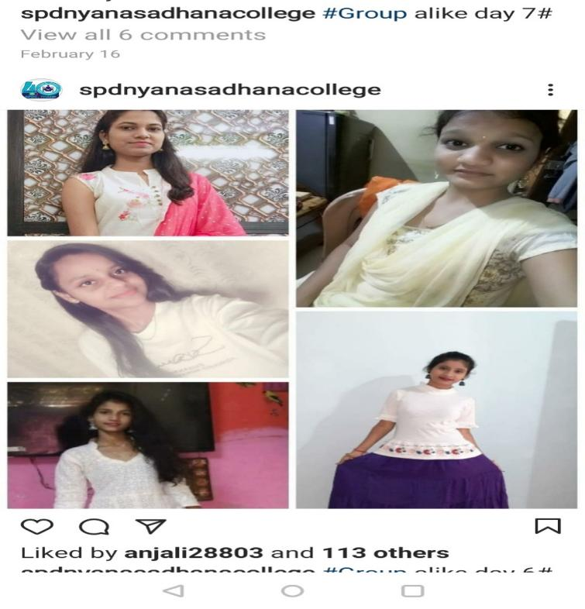
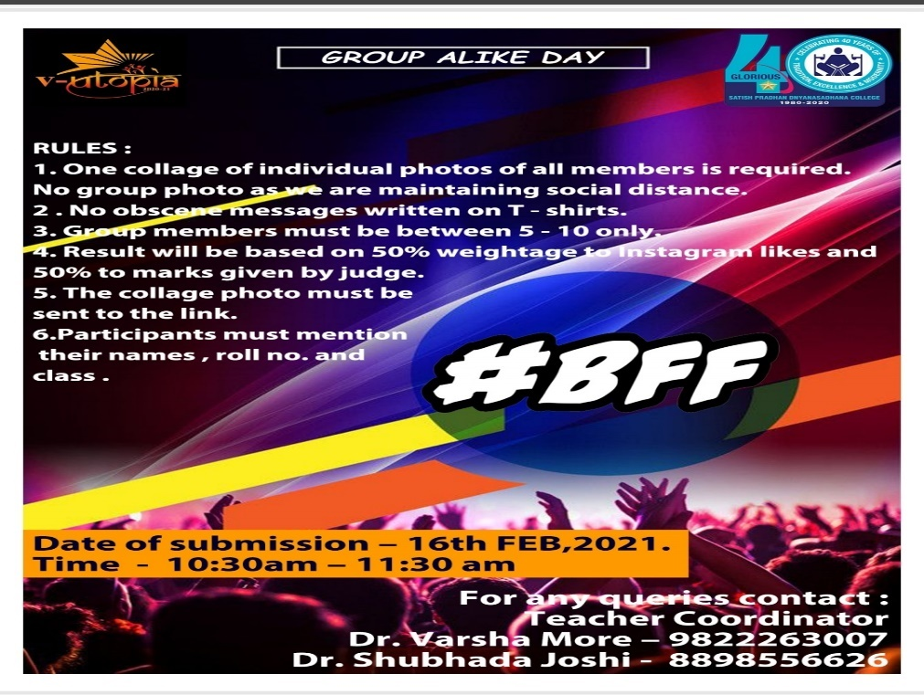
EVENT # 3 : Intra-college - Group Alike Day
Winner Group Name – Amhi Dnyanasadhana Wale

Slide 5
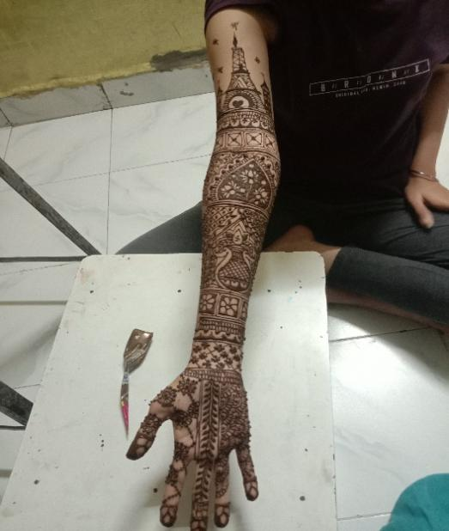
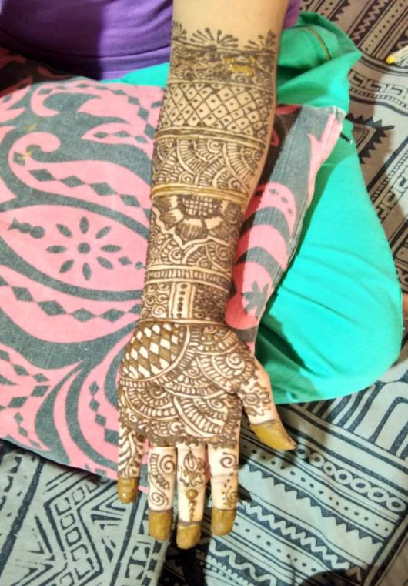
EVENT # 4 : Intra-college - Mehendi

Slide 6
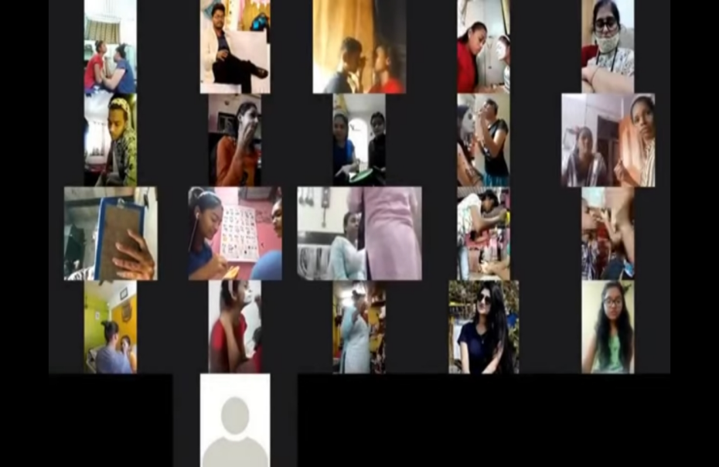
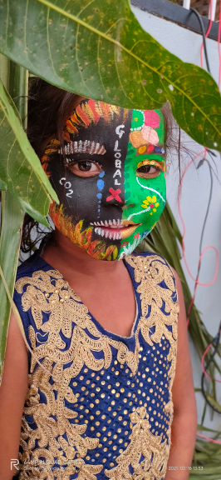
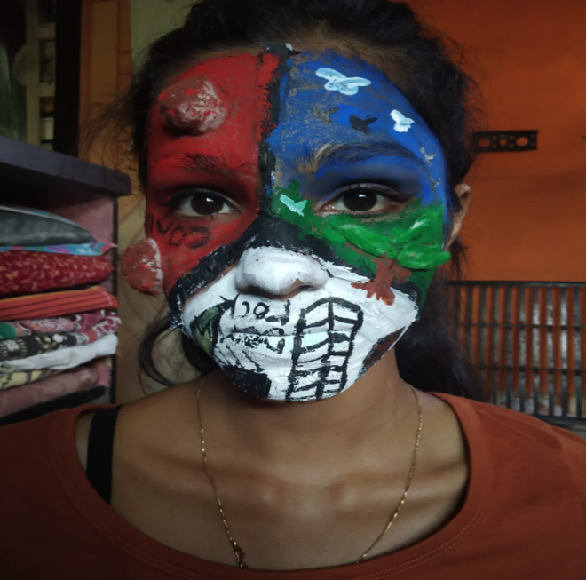
EVENT # 5 : Intra-college - Face Painting

Slide 7
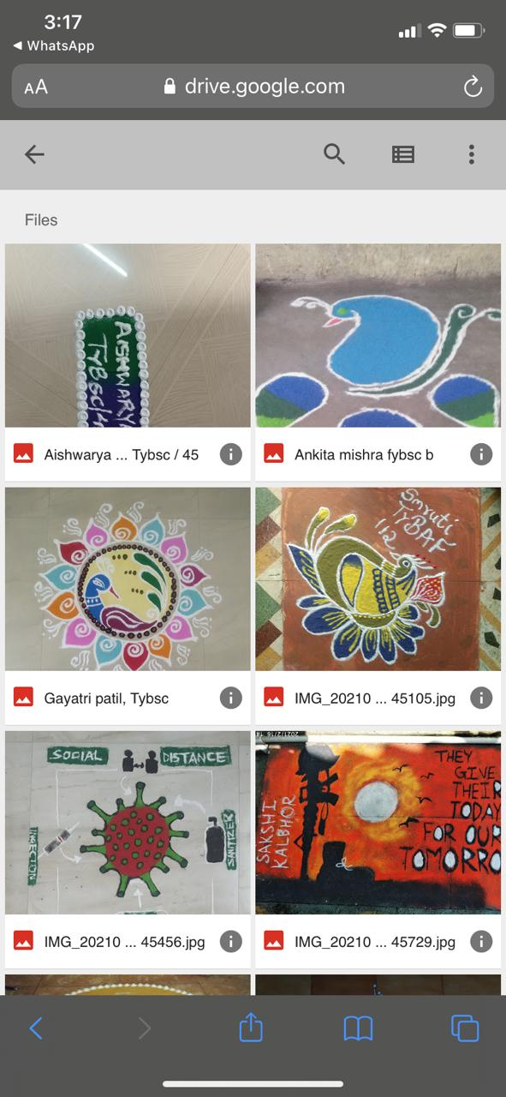
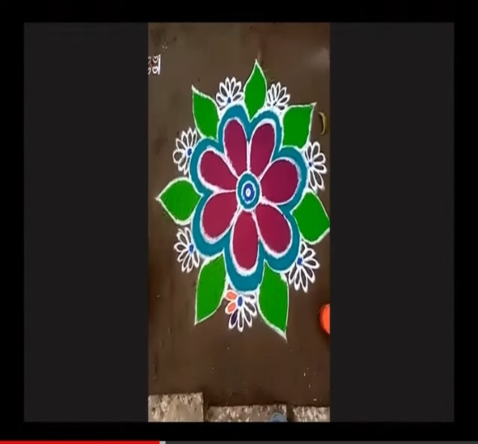
EVENT # 6: Intra-college - Rangoli

Slide 8
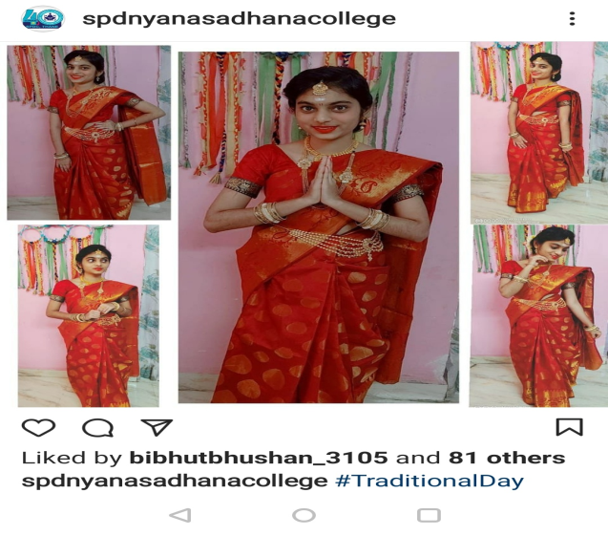
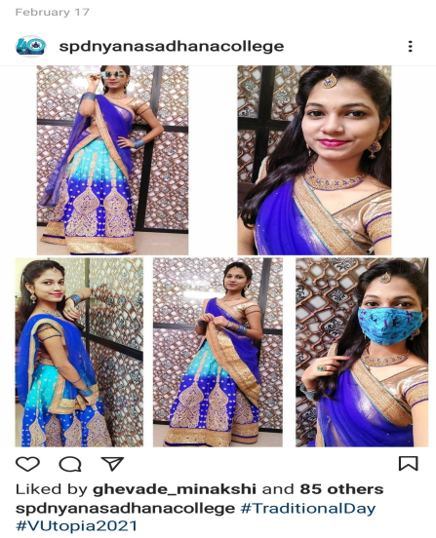
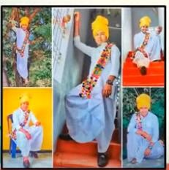
EVENT # 7 : TRADITIONAL DAY

Slide 9
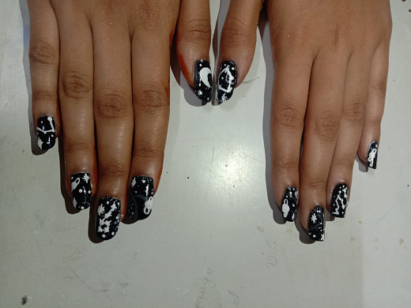
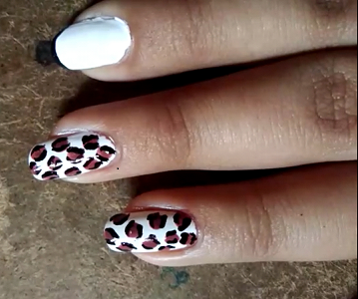
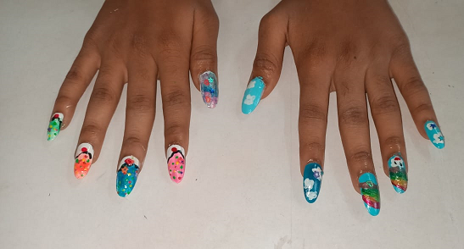
EVENT # 8 : NAIL ART

Slide 10
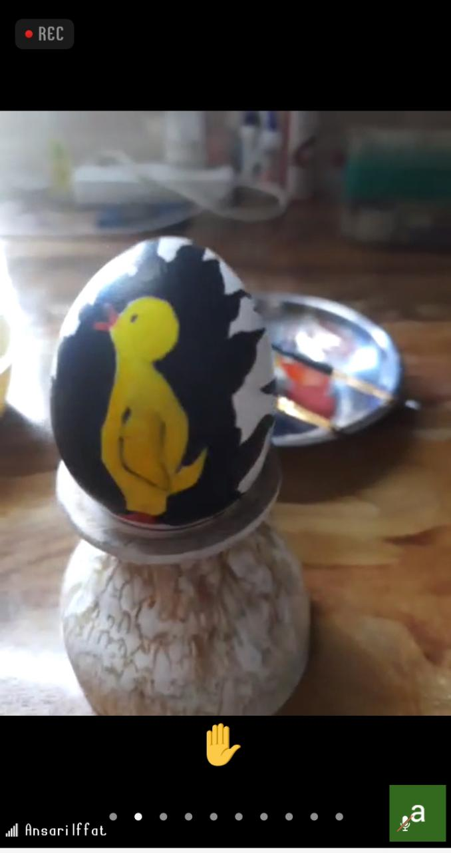
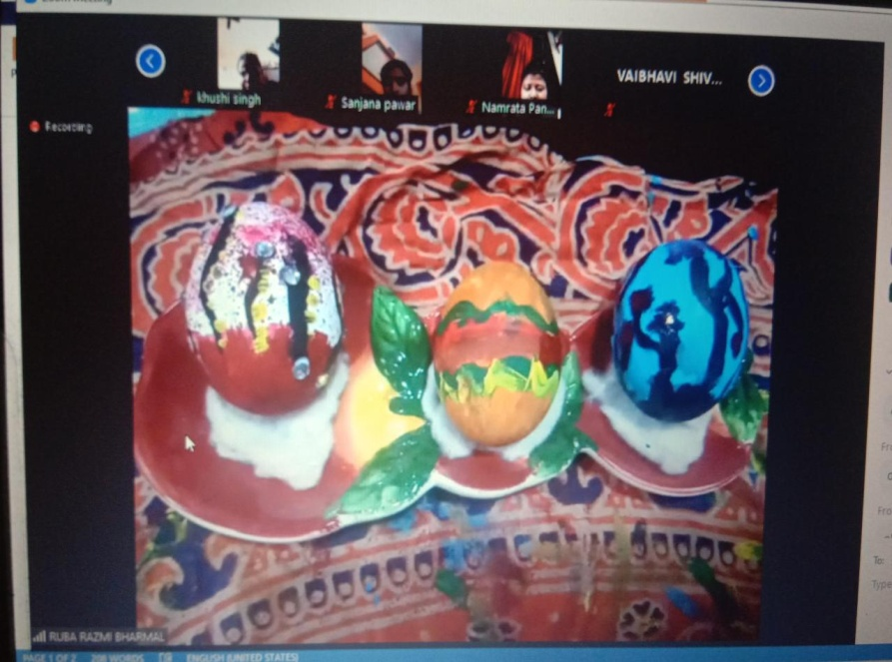
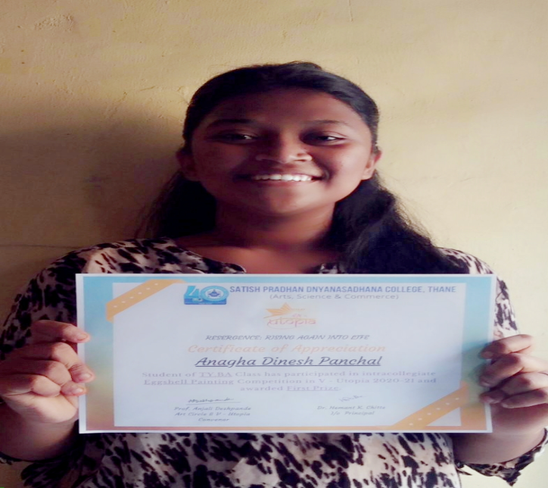
EVENT # 9: EGG-SHELL PAINTING
First prize winner

Slide 11
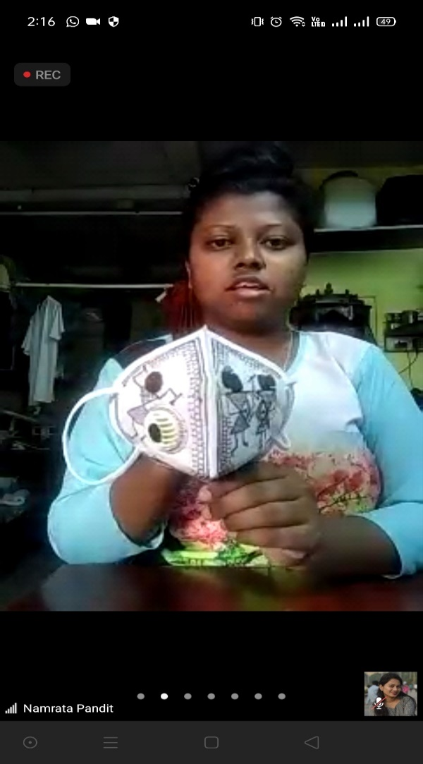
EVENT#10 : MASK DESIGN

Slide 12
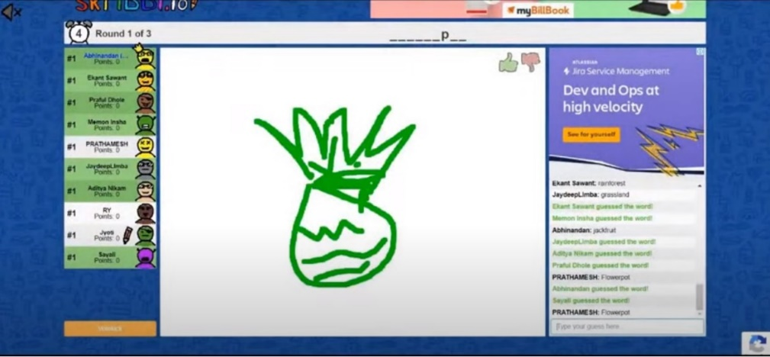
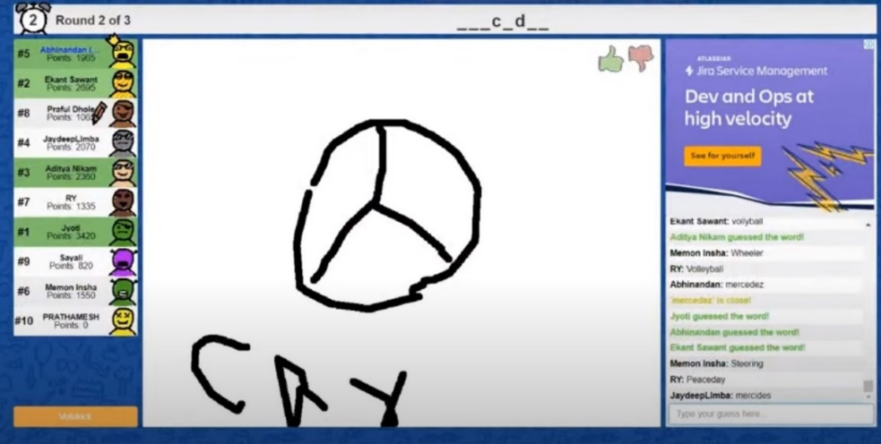
EVENT # 11 : SKRIBBL

Slide 13
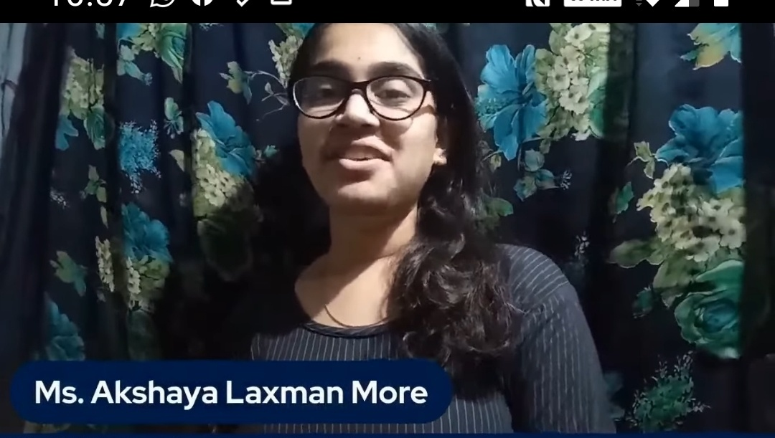
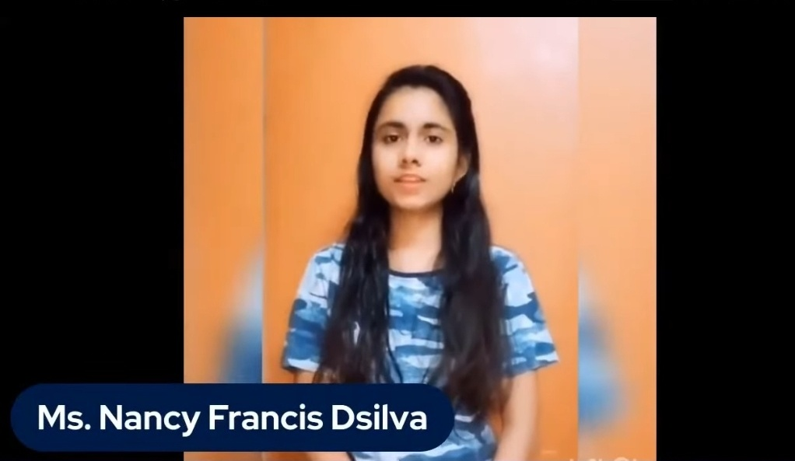
EVENT # 12 : SOLO SINGING

Slide 14
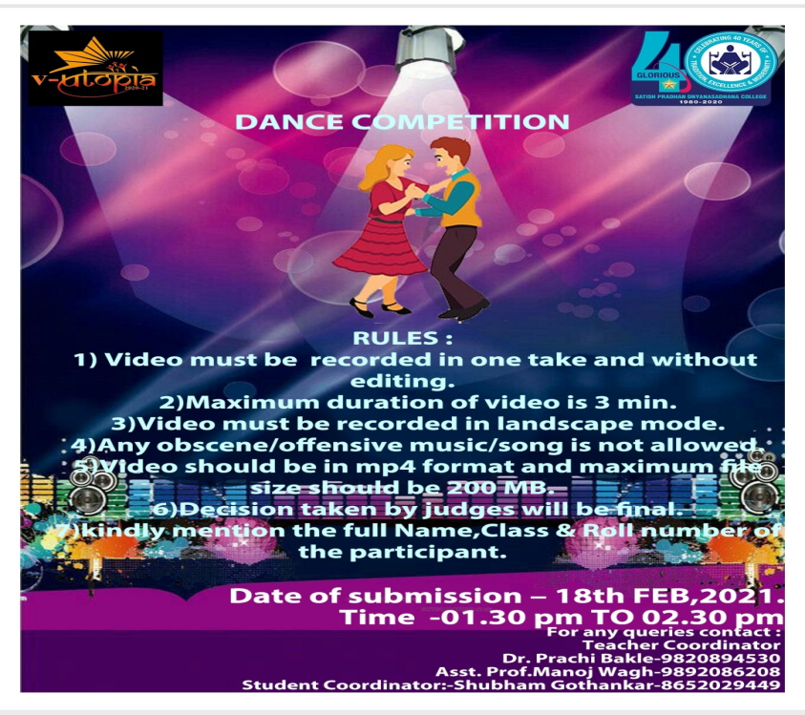
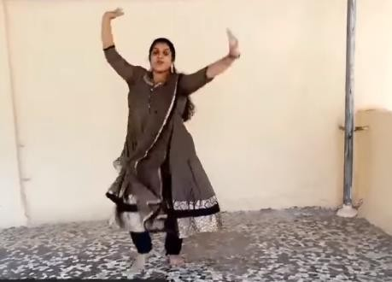
EVENT # 13: SOLO DANCE

Slide 15
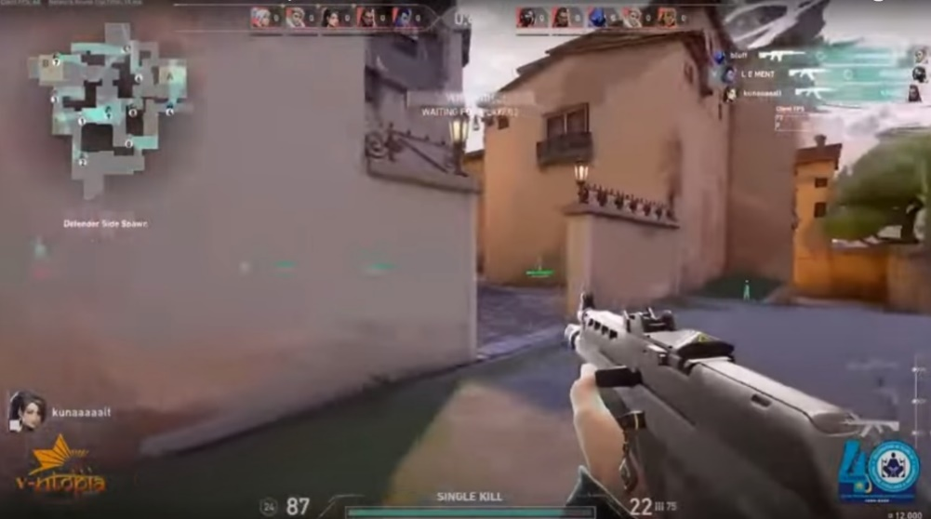
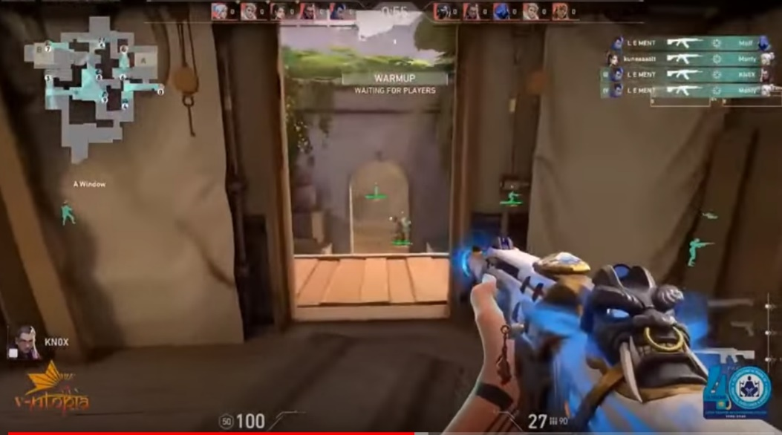
EVENT # 13 : VALORANT
1st WINNER - PRATHAMESH JOSHI
COLLEGE - PODAR INTERNATIONAL SCHOOL
2nd WINNER - EKANT SAWANT
COLLEGE - SATISH PRADHAN DNYANASADHANA

Slide 16
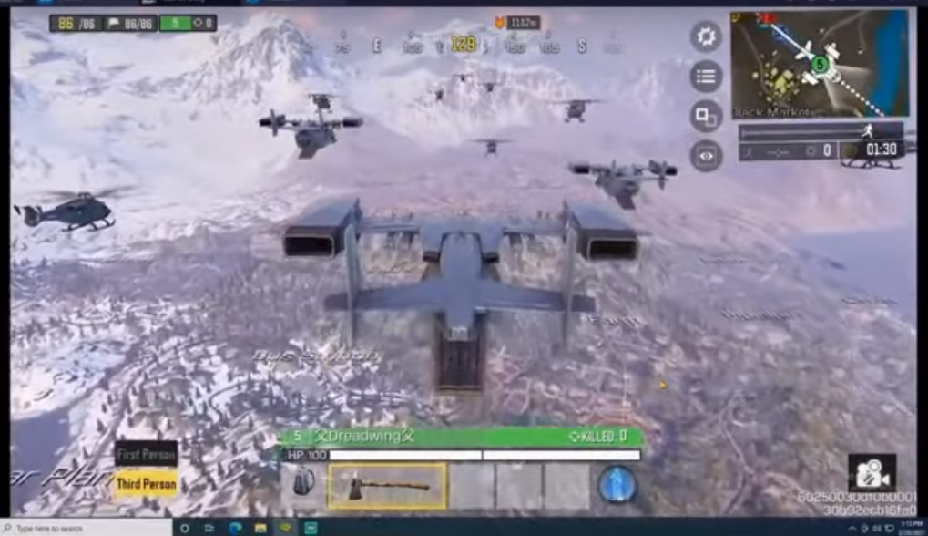
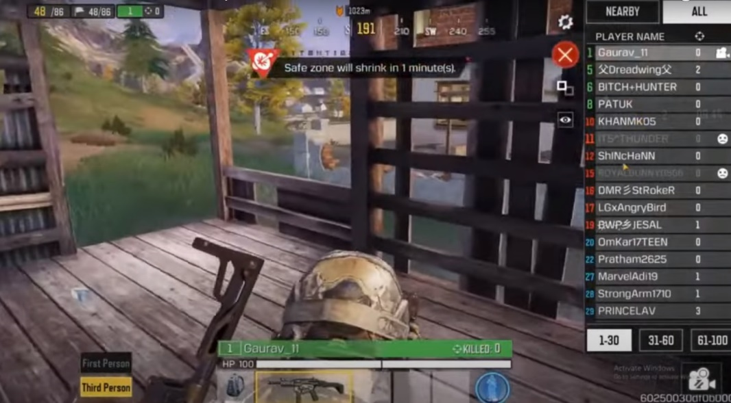
EVENT # 14 : CALL OF DUTY MOBILE

Slide 17
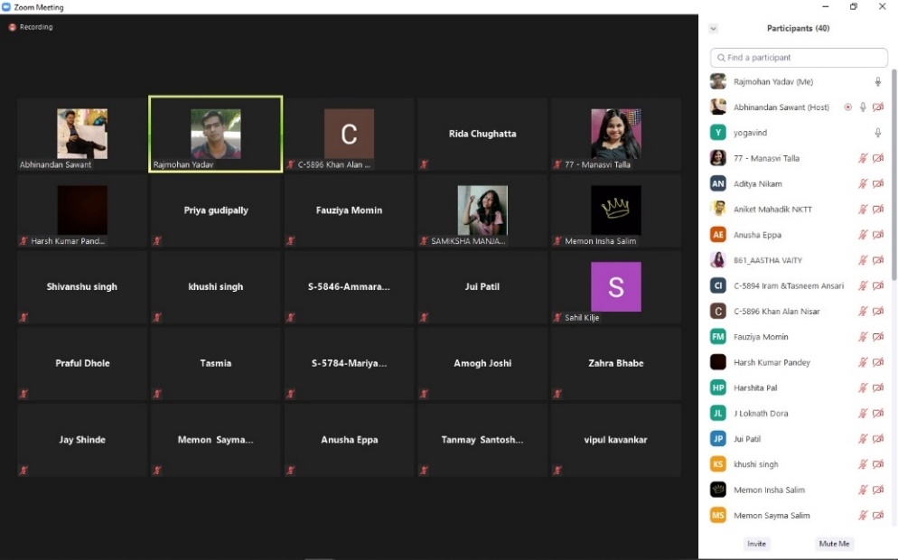
EVENT # 15 : TREASURE HUNT

Slide 18
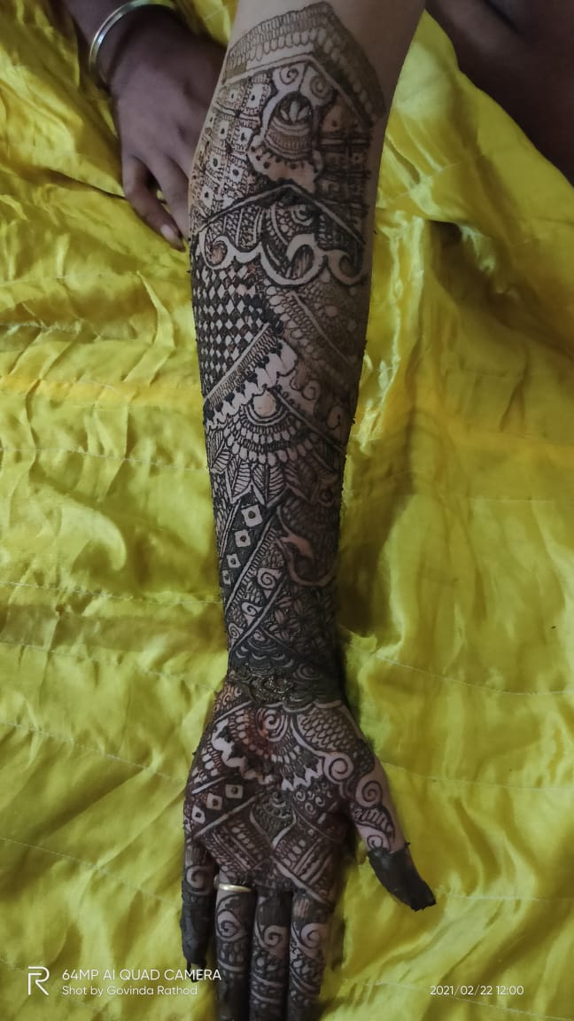
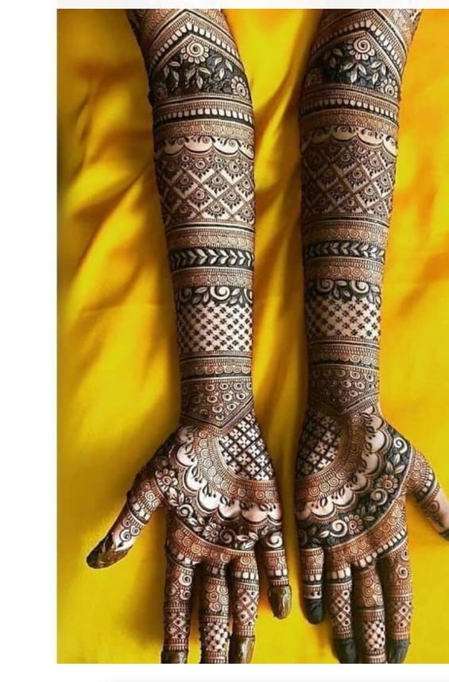
EVENT # 16 : MEHENDI
1st WINNER - MASHIRA YAKUB GOGDA ( NES RATNAM COLLEGE OF ARTS, SCIENCE AND COMMERCE)
2nd WINNER - ANAM RIZWAN MANI (BIRLA COLLEGE)
3rd WINNER - POOJA PAPARAO LINGAM (SATISH PRADHAN DNYANASADHANA)
CONSOLATION PRIZE - MOALIM ISHA FARZAN ( G . M MOM IN WOMEN'S COLLEGE )

Slide 19
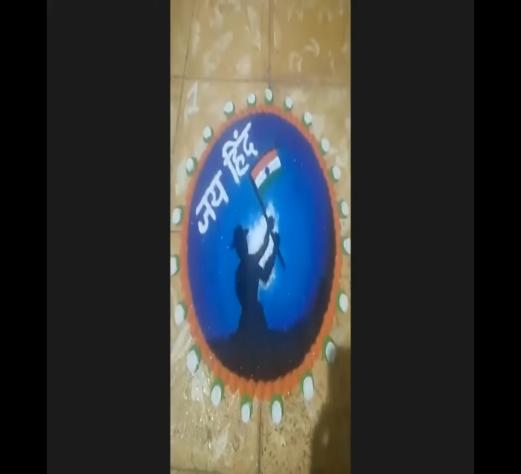
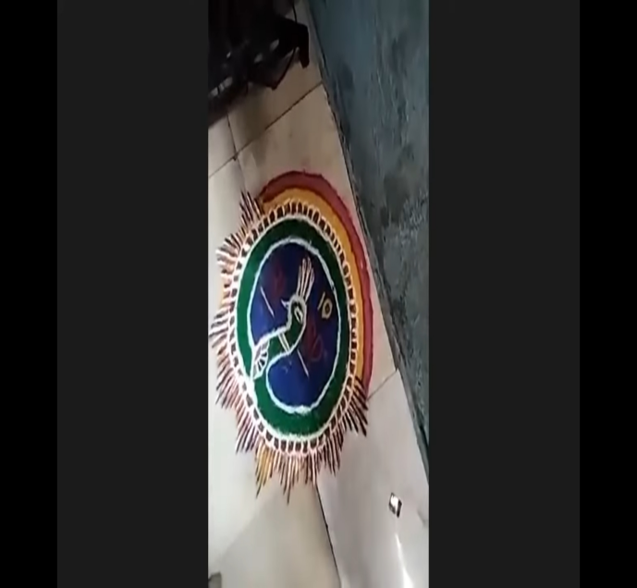
EVENT # 17 : RANGOLI
1st WINNER - JENIL DHIRAJ SONEJI
2nd WINNER - JUI ASHIKKUMAR PATIL

Slide 20
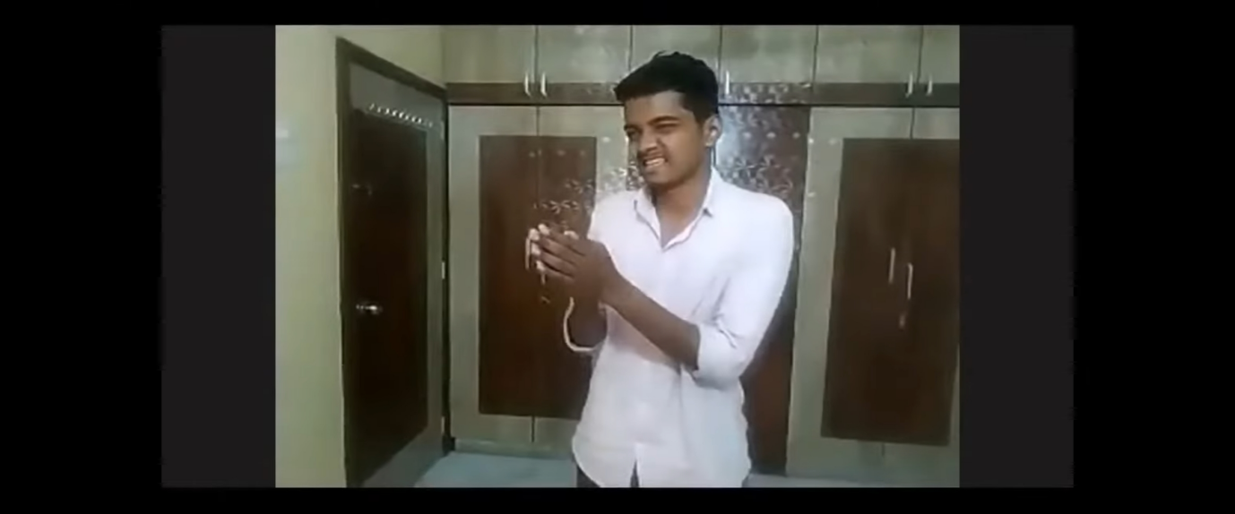
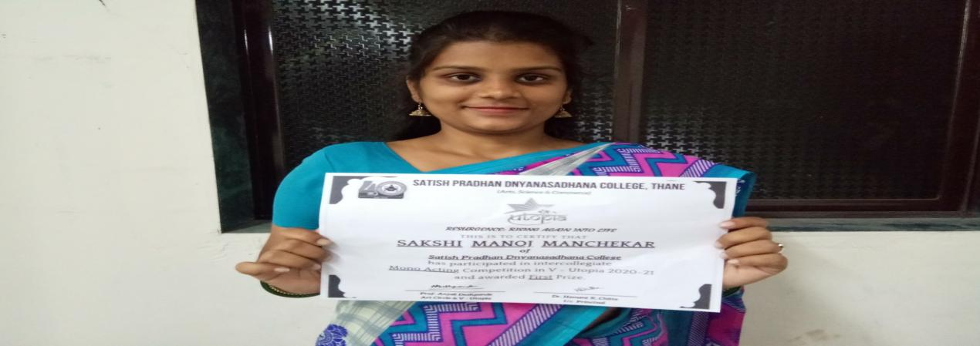
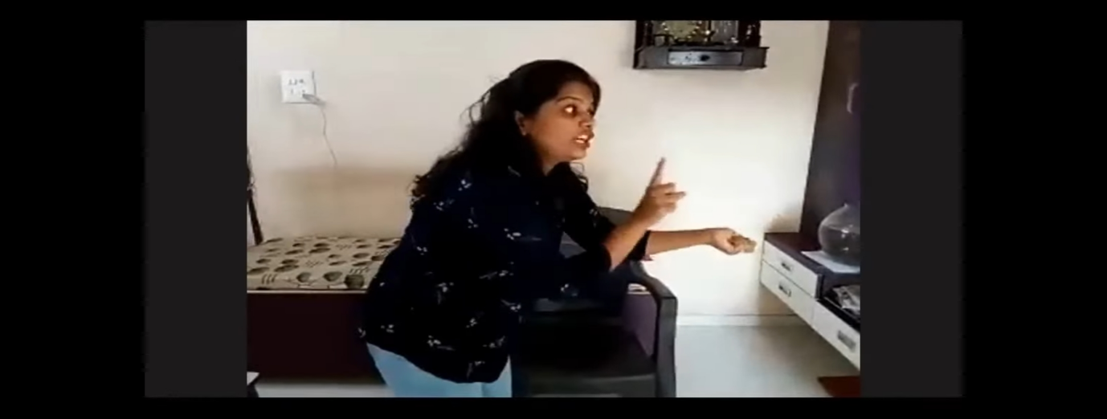
EVENT # 18 : MONO- ACTING

Slide 21
EVENT # 19 : POSTER MAKING COMPETITION

Slide 22
EVENT # 20 : PPT PRESENTATION COMPETITION

Slide 23
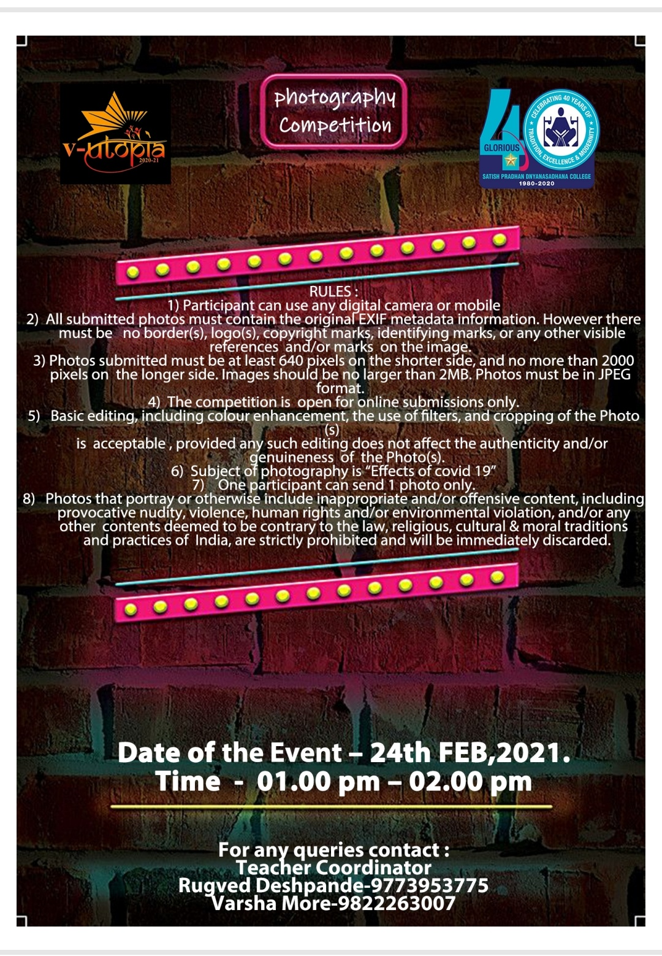
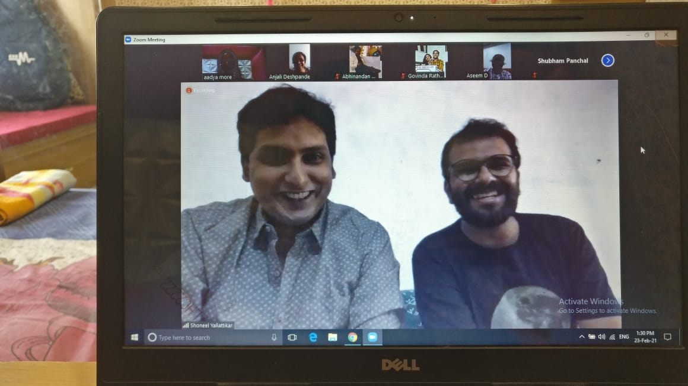
EVENT # 21 : PHOTOGRAPHY

Slide 24
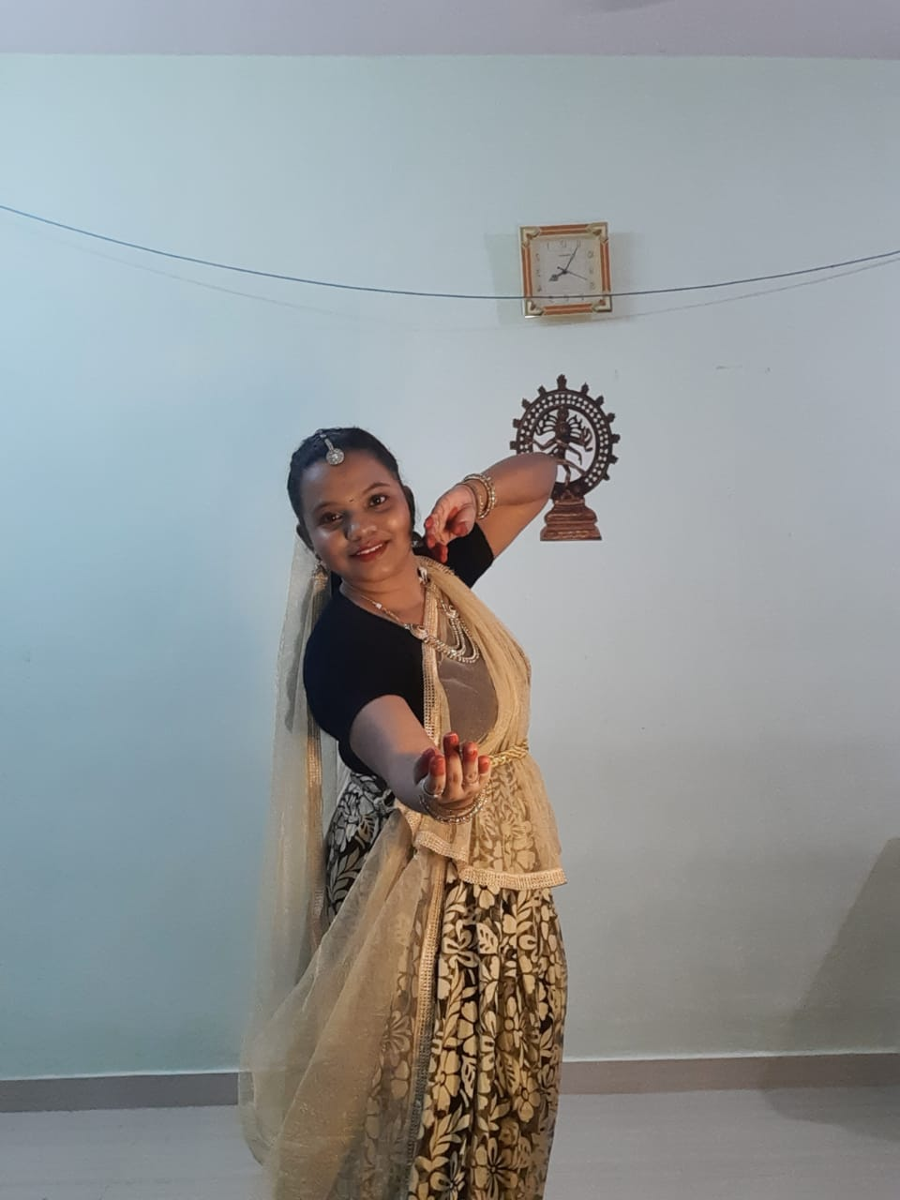
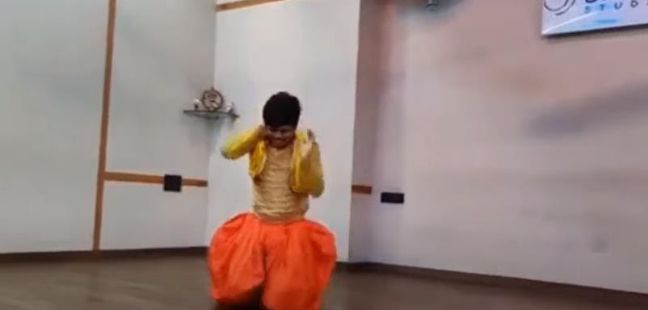
EVENT # 22 : SOLO DANCE

Slide 25
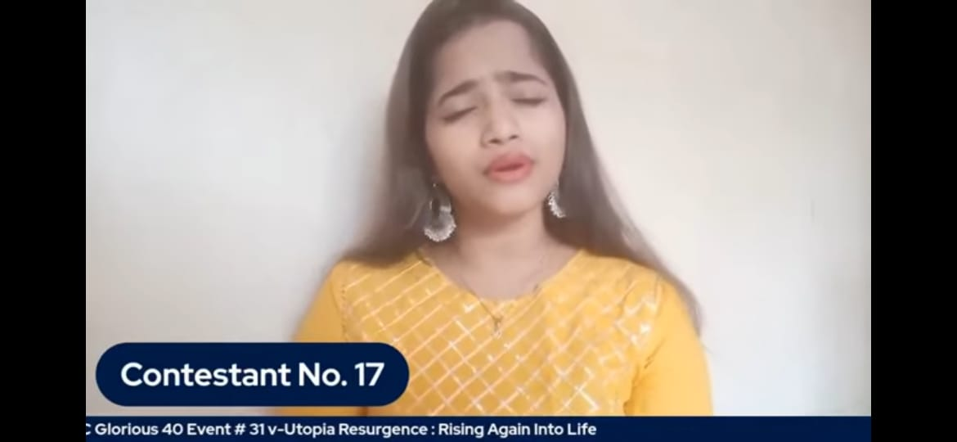
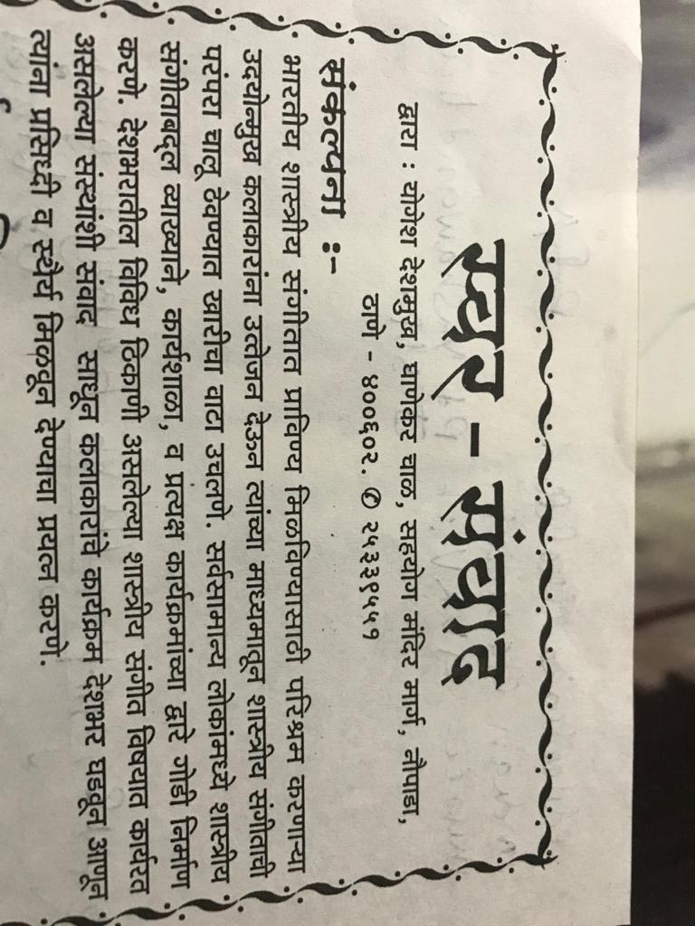
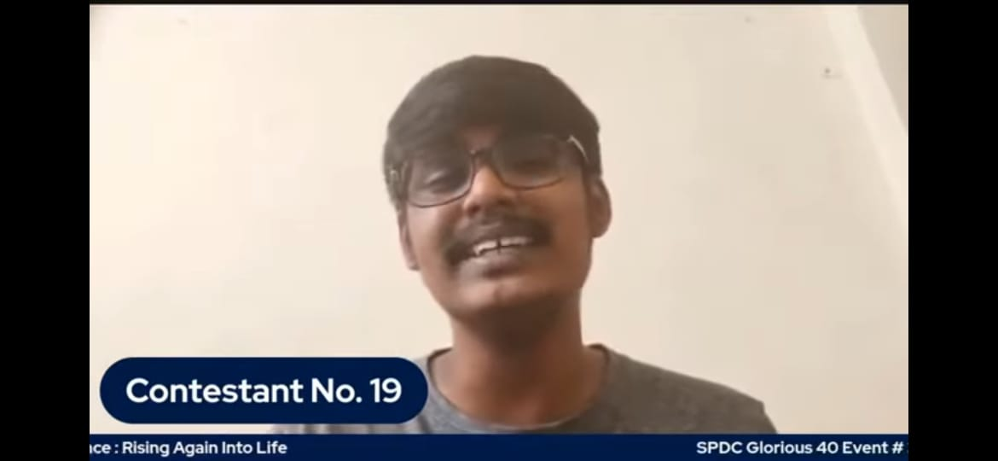
EVENT # 23 : SOLO SINGING

Slide 26
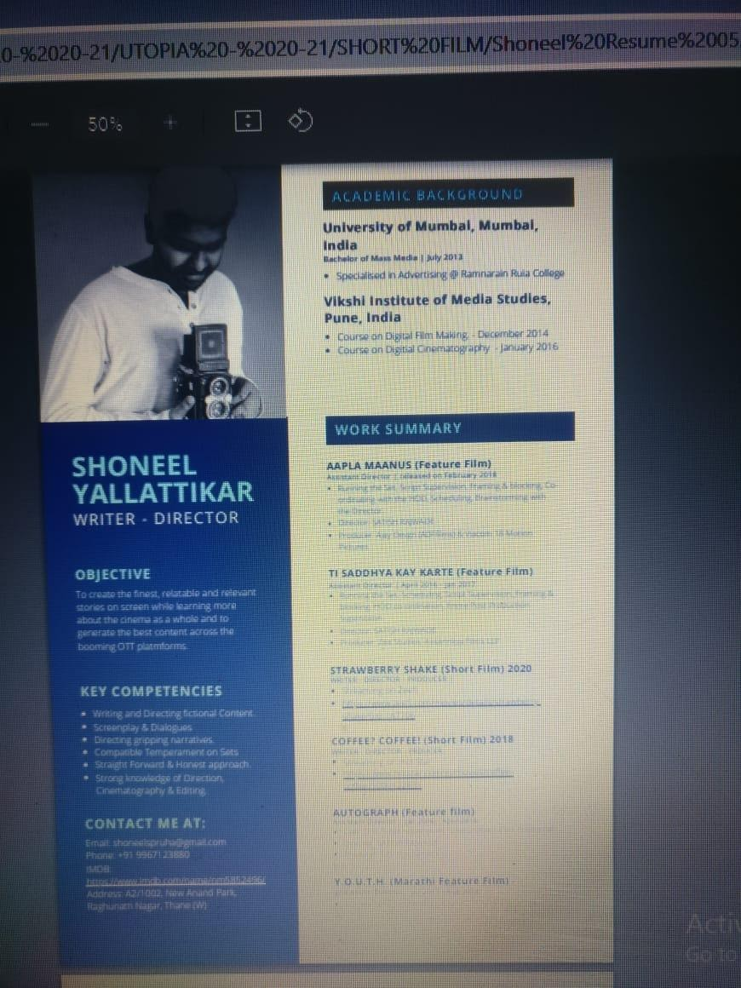
EVENT # 24 : SHORT FILM

Slide 27
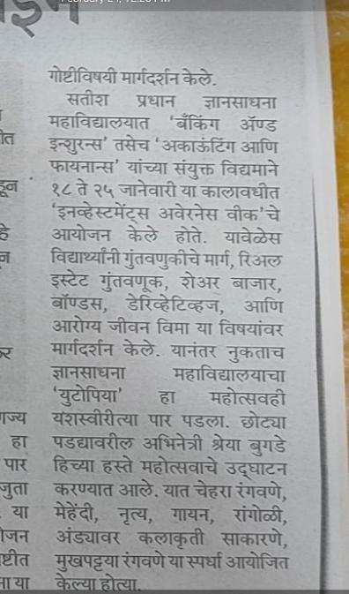
Media coverage
Media coverage

Slide 28
EVENT # 25 : VALEDICTORY FUNCTION
CERTIFICATE OF INTRACOLLEGIATE EVENTS
VOLUNTARY CERTIFICATE

